Slide 1
Reinforcement Learning for LQ Mean-Field Games in Multiple Populations
Muhammad Aneeq uz Zaman, Erik Miehling, Tamer Başar
University of Illinois Urbana-Champaign

Slide 2
Outline
Motivation
Background on Linear-Quadratic Mean-Field Games (LQ-MFGs)
Multi-population LQ-MFGs
Mean-Field Equilibria (MFE)
Existence & Uniqueness of (Non-stationary) MFE
ε-Nash guarantees for MFE
Reinforcement Learning (RL) Algorithm for MFE
Zero-order Stochastic Optimization (ZSO) based RL
Finite Sample guarantees for ZSO-RL algorithm
Numerical Analysis

Slide 3
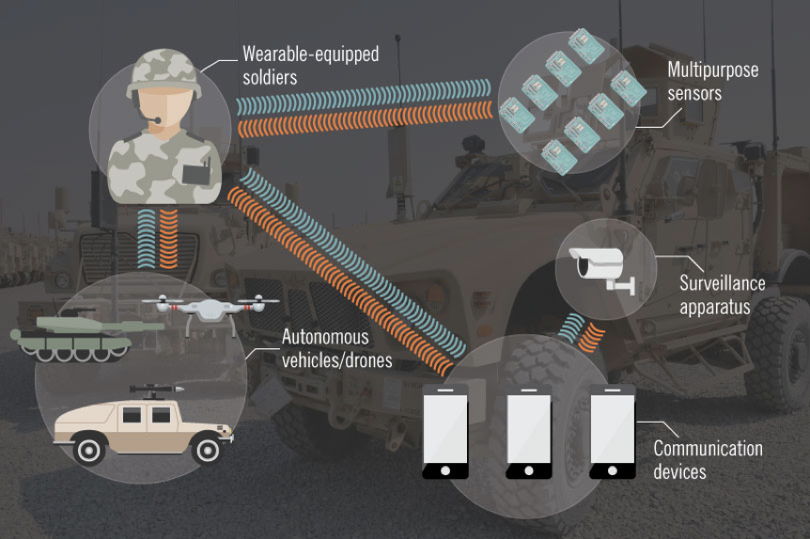
Motivation
Strategic agents in heterogeneous populations
Modern battlefield scenarios require many heterogeneous agents to learn via interaction with the battlefield environment
Goal: To enable a large number of heterogeneous strategic agents to learn consensus or formation-control behaviors in a model-free manner
Scientific Contributions
Development of a learning algorithm for mean-field games based on zero-order stochastic optimization techniques
Demonstrate that multi-agent reinforcement learning in large, heterogeneous populations can be effectively addressed within the framework of mean-field games

Slide 4
Literature Review
MFGs seminal works (Huang et al., 2006; Lasry and Lions, 2007)
LQ-MFGs
Continuous-time (Huang et al., 2007; Bensoussan et al.,2016)
Discrete-time (Moon and Başar, 2014; Zaman et al., 2020a)
RL for LQ-MFGs
Stationary equilibria (Fu et al., 2020)
Non-stationary equilibria (Zaman et al.,2020b)
MFGs on Networks (agents travel on a network)
(Camilli and Marchi, 2016; Achdou et al.,2020)
Networked MFGs (agents coupled via a network)
Erdős–Rényi graphs (Delarue, 2017)
Graphon MFGs (Caines and Huang, 2019; Gao et al., 2020)
MFGs on multigraphs (Zaman et al., 2021)

Slide 5
Contribution
Formulation of Multi-population LQ-MFG
Agents partitioned in heterogeneous populations
Existence, Uniqueness & Structure of MFE
Existence & Uniqueness under standard conditions (controllability, observability)
Affine structure of MFE (controller and mean-field)
ε-Nash (Approximately Nash) guarantee for MFE
MFE will be ε-Nash in finite population setting
Provably-convergent RL algorithm for MFG
Truly model-free method using Zero-order Stochastic Optimization (ZSO)
Centralized (noisy) simulator for aggregate behavior

Slide 6
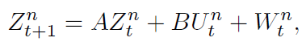
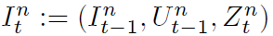
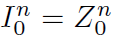
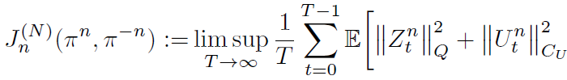
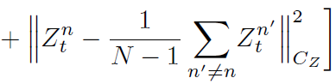
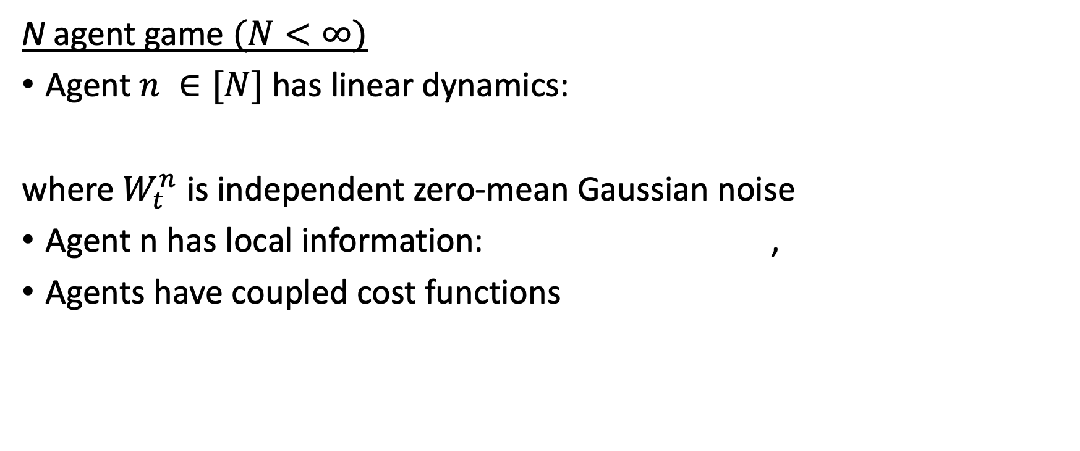
Background on LQ Mean-Field Games
N agent game $(N<∞)$
Agent $n ∈[N]$ has linear dynamics:
where $W_{t}^{n}$ is independent zero-mean Gaussian noise
Agent n has local information: ,
Agents have coupled cost functions
Regulation
Consensus

Slide 7
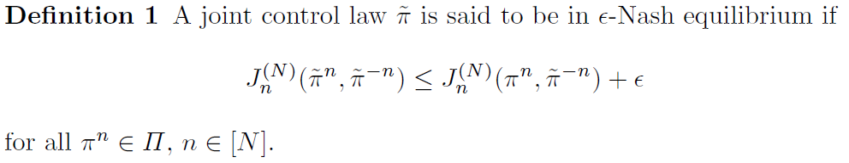
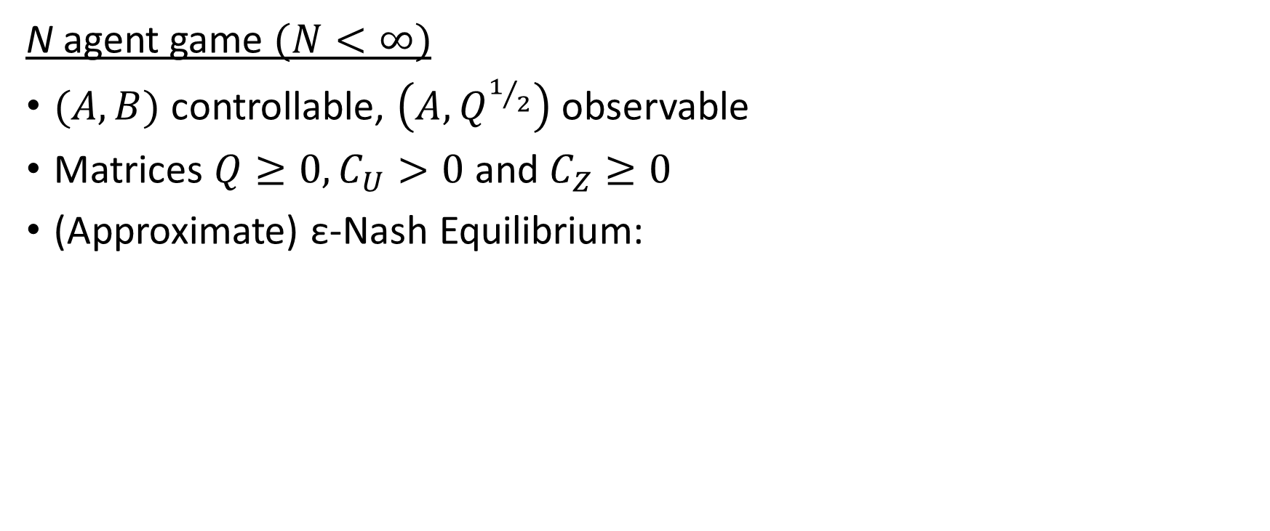
Background on LQ Mean-Field Games
N agent game $(N<∞)$
$(A,B)$ controllable, $\left(A,Q^{1/2}\right)$ observable
Matrices $Q≥0, C_{U}>0$ and $C_{Z}≥0$
(Approximate) ε-Nash Equilibrium:

Slide 8
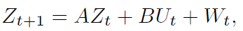
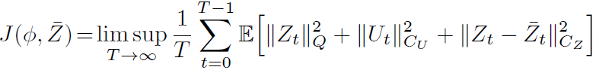
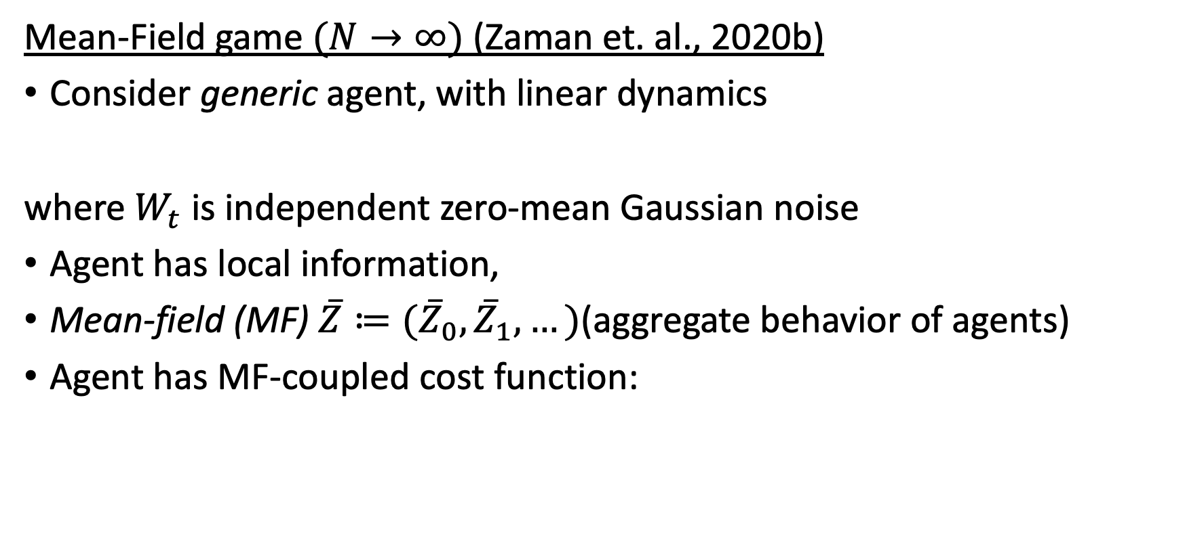
Background on LQ Mean-Field Games
Mean-Field game $(N→∞)$ (Zaman et. al., 2020b)
Consider generic agent, with linear dynamics
where $W_{t}$ is independent zero-mean Gaussian noise
Agent has local information,
Mean-field (MF) $\overline{Z}≔({\overline{Z}}_{0},{\overline{Z}}_{1},…)$(aggregate behavior of agents)
Agent has MF-coupled cost function:
Regulation
Consensus

Slide 9
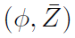
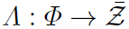
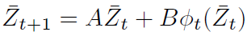
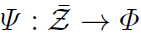
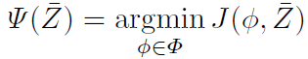
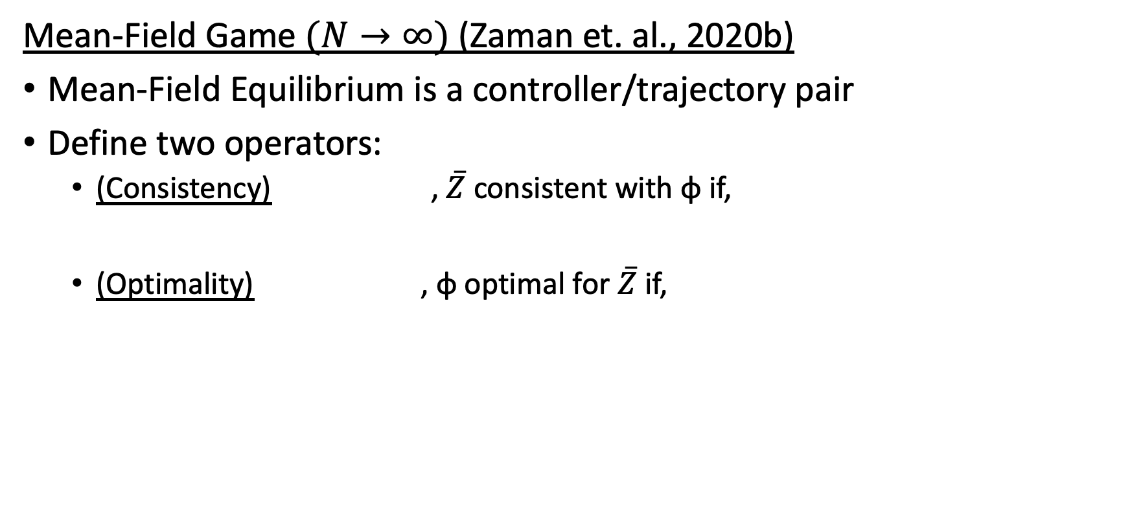
Background on LQ Mean-Field Games
Mean-Field Game $(N→∞)$ (Zaman et. al., 2020b)
Mean-Field Equilibrium is a controller/trajectory pair
Define two operators:
(Consistency) , $\overline{Z}$ consistent with φ if,
(Optimality) , φ optimal for $\overline{Z}$ if,

Slide 10
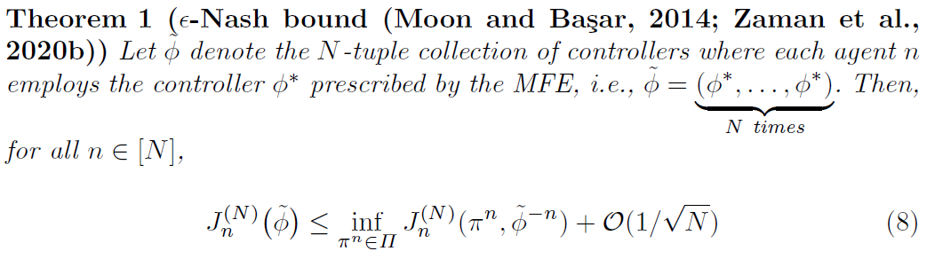
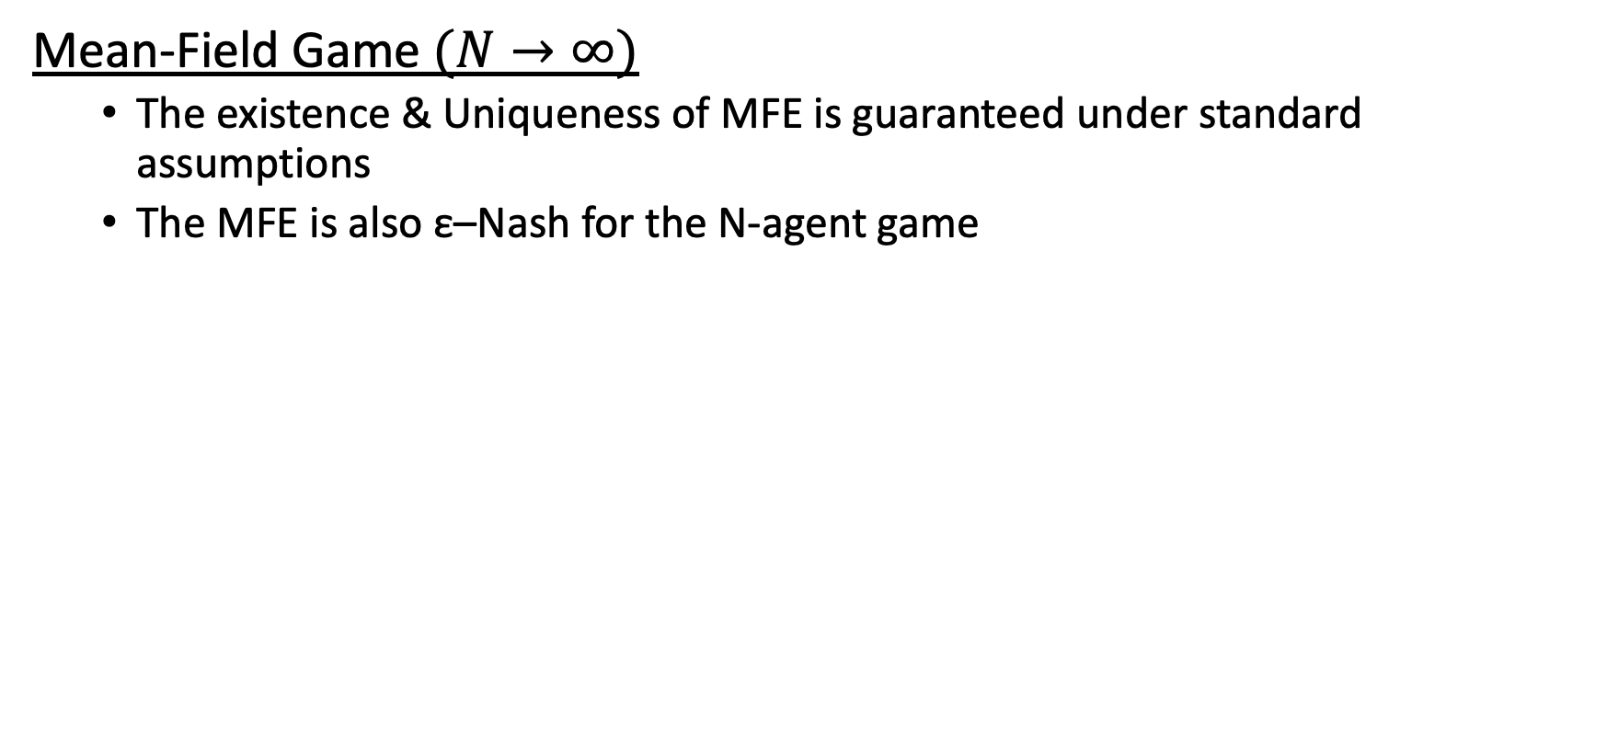
Background on LQ Mean-Field Games
Mean-Field Game $(N→∞)$
The existence & Uniqueness of MFE is guaranteed under standard assumptions
The MFE is also ε–Nash for the N-agent game

Slide 11
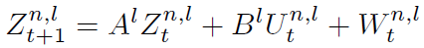
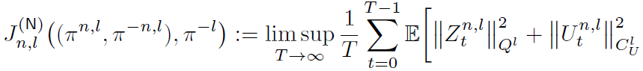
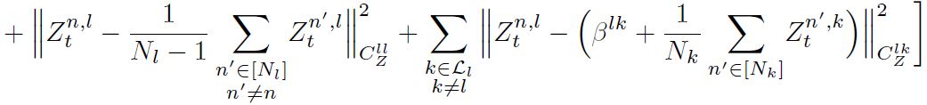
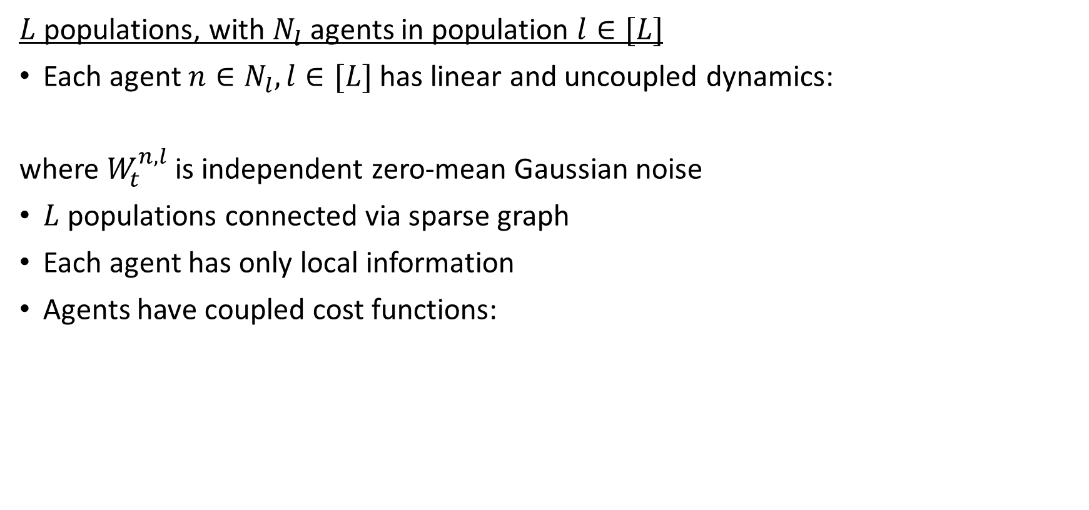
Multi-Population MFGs
$L$ populations, with $N_{l}$ agents in population $l∈[L]$
Each agent $n∈N_{l},l∈[L]$has linear and uncoupled dynamics:
where $W_{t}^{n,l}$ is independent zero-mean Gaussian noise
$L$ populations connected via sparse graph
Each agent has only local information
Agents have coupled cost functions:
Regulation
Intra-Population consensus
Inter-Population consensus

Slide 12
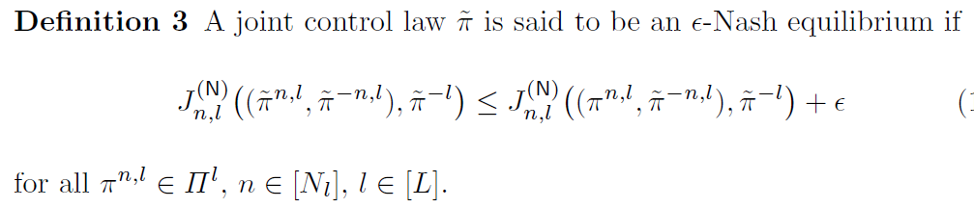
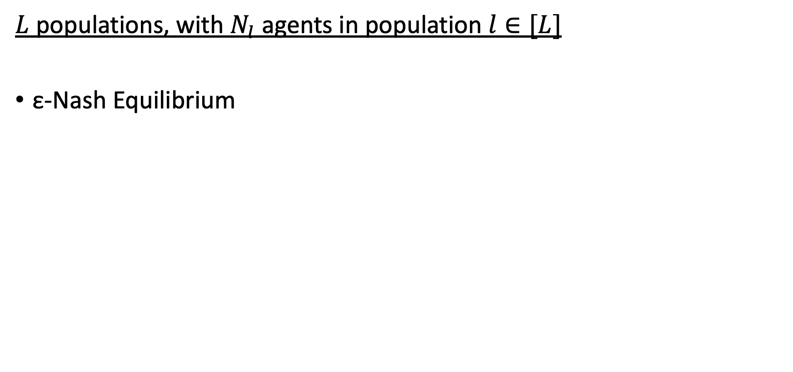
Multi-Population MFGs
$L$ populations, with $N_{l}$ agents in population $l∈[L]$
ε-Nash Equilibrium

Slide 13
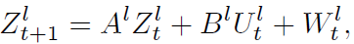
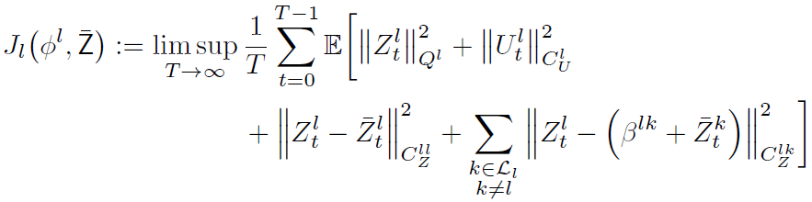
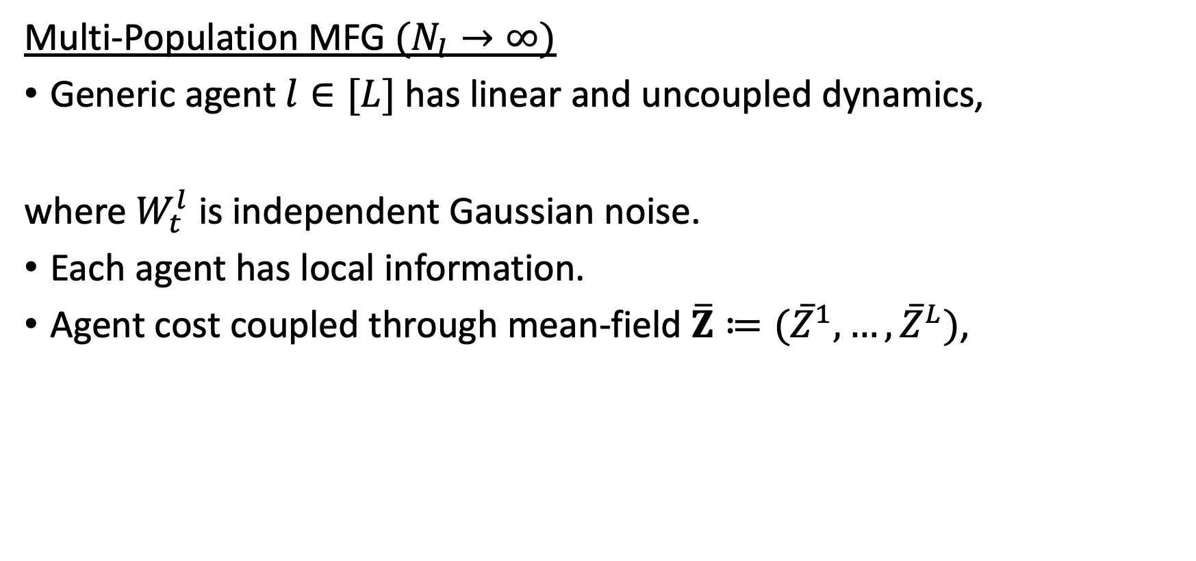
Multi-Population MFGs
Multi-Population MFG $(N_{l}→∞)$
Generic agent $l∈[L]$has linear and uncoupled dynamics,
where $W_{t}^{l}$ is independent Gaussian noise.
Each agent has local information.
Agent cost coupled through mean-field $\overline{Z}≔({\overline{Z}}^{1},…,{\overline{Z}}^{L})$,
Regulation
Inter-Population consensus
Intra-Population consensus

Slide 14
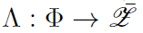
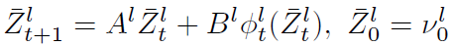
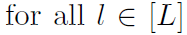
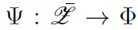
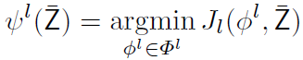
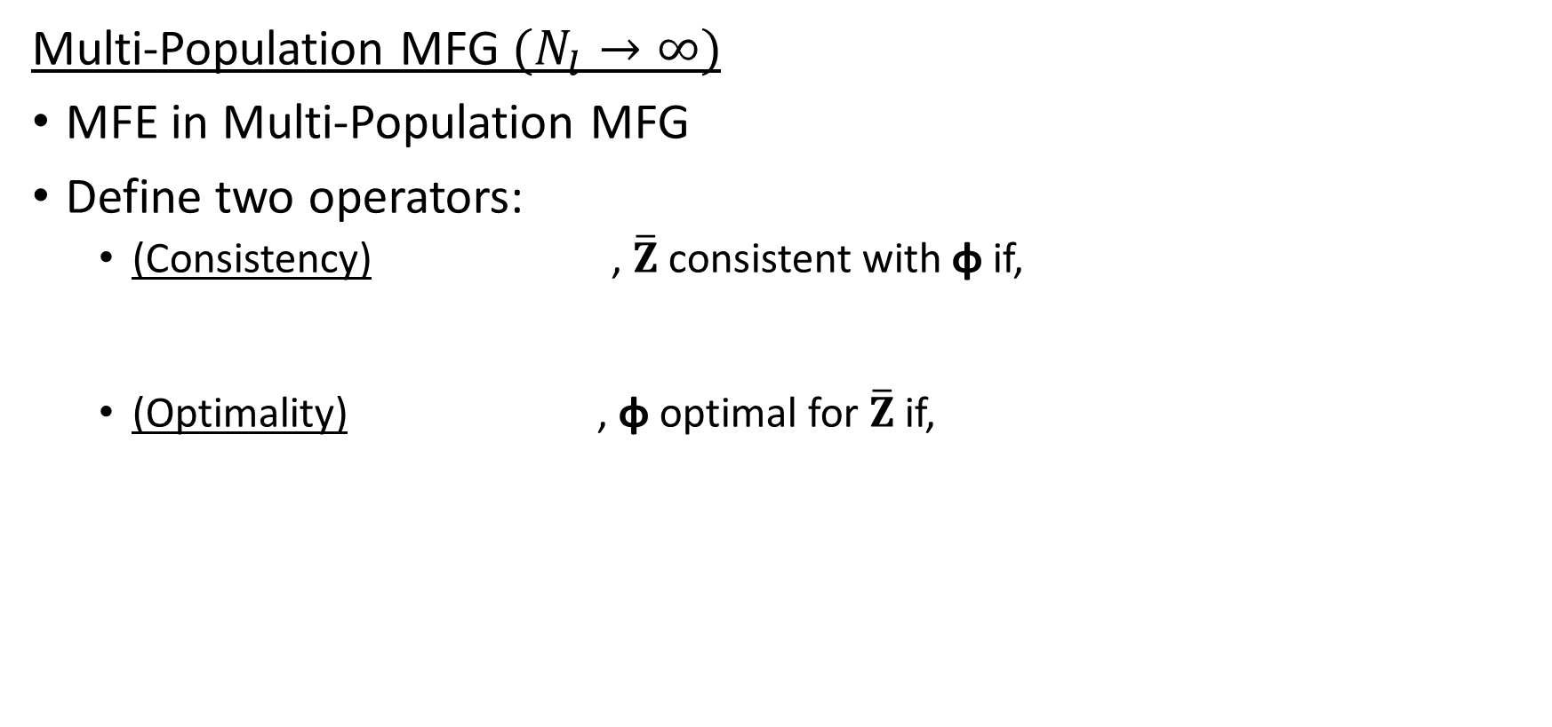
Multi-Population MFGs
Multi-Population MFG $(N_{l}→∞)$
MFE in Multi-Population MFG
Define two operators:
(Consistency) , $\overline{Z}$consistent with φ if,
(Optimality) , φ optimal for $\overline{Z}$if,

Slide 15
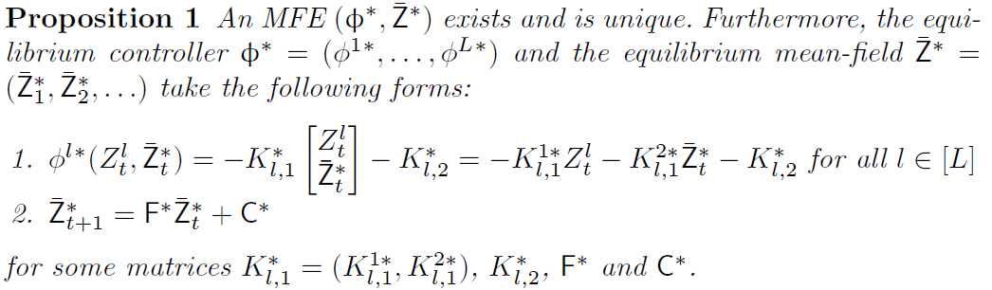
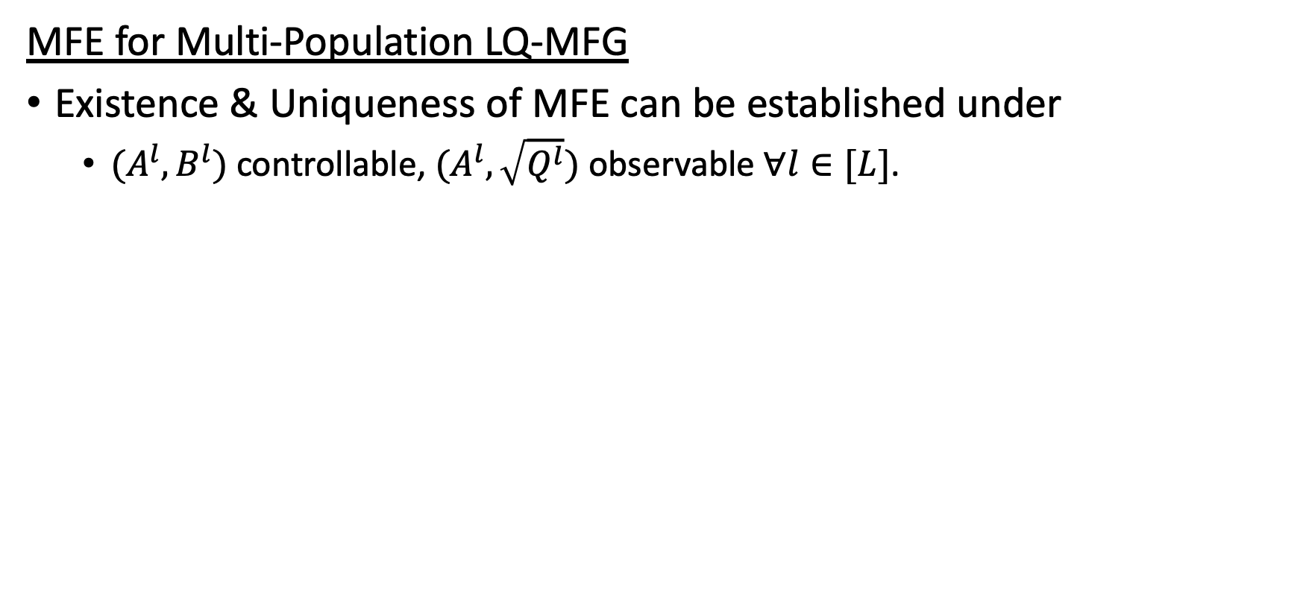
Existence & Uniqueness of MFE
MFE for Multi-Population LQ-MFG
Existence & Uniqueness of MFE can be established under
$(A^{l},B^{l})$ controllable, $(A^{l},\sqrt{Q^{l}})$ observable $∀l∈[L]$.
Linear terms
Offset terms

Slide 16
Existence & Uniqueness of MFE
Outline of Proof
Existence, uniqueness & affineness of MF proved using probabilistic approach (Carmona and Delarue, 2018)
Leads to Riccati equation in standard form.
Equilibrium controller is solution to an LQ (affine-)tracking problem
proved using stochastic maximum principle.
Implications of Proposition 1
At Equilibrium:
MF has deterministic affine dynamics (offline computation)
Controller is causal, distributed and affine
Causal controller allows for RL in “Non-Stationary” setting
Major contribution of this work

Slide 17
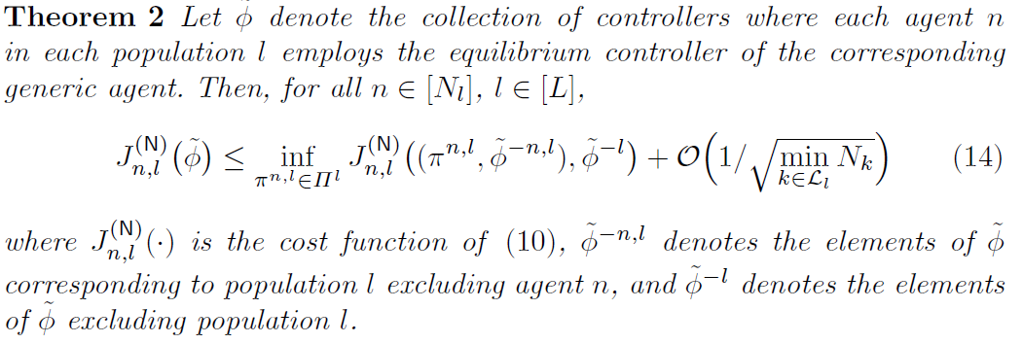
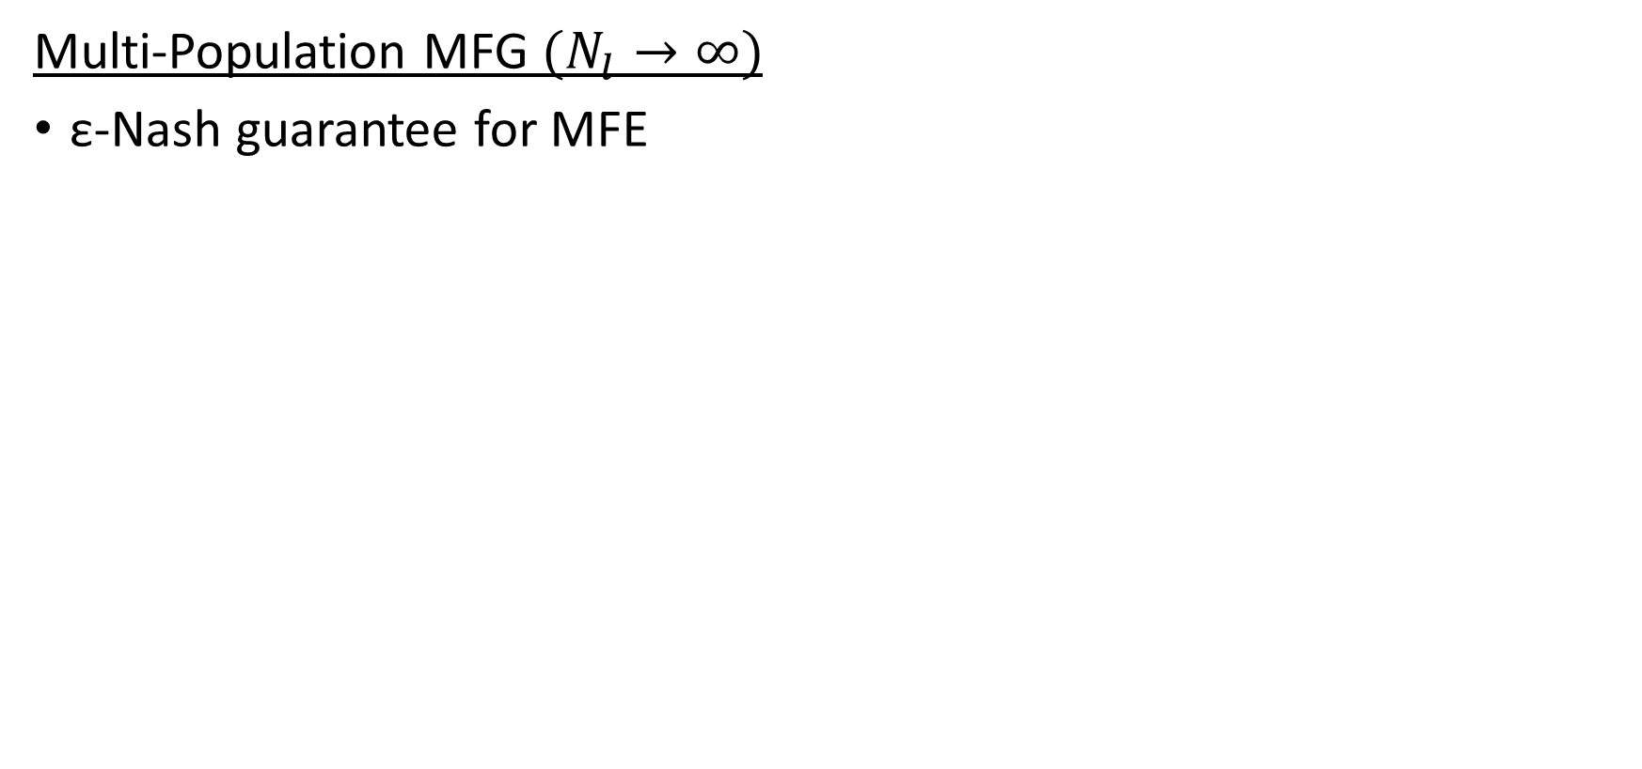
ε-Nash guarantee
Multi-Population MFG $(N_{l}→∞)$
ε-Nash guarantee for MFE

Slide 18
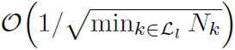
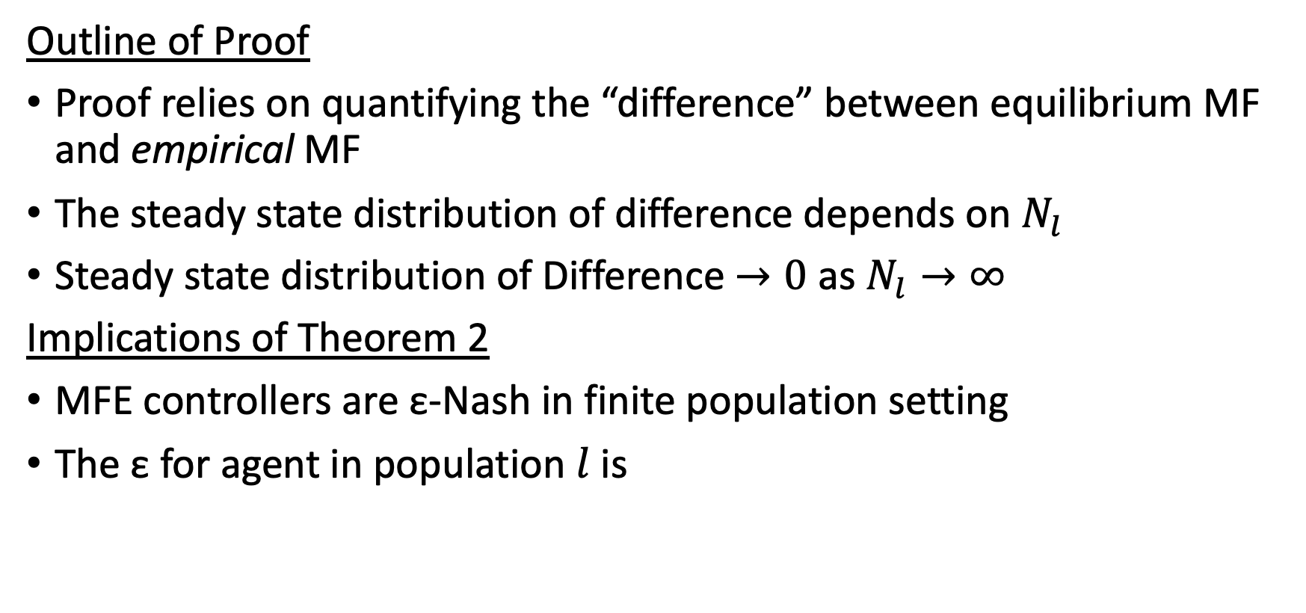
ε-Nash guarantee
Outline of Proof
Proof relies on quantifying the “difference” between equilibrium MF and empirical MF
The steady state distribution of difference depends on $N_{l}$
Steady state distribution of Difference $→0$ as $N_{l}→∞$
Implications of Theorem 2
MFE controllers are ε-Nash in finite population setting
The ε for agent in population $l$ is

Slide 19
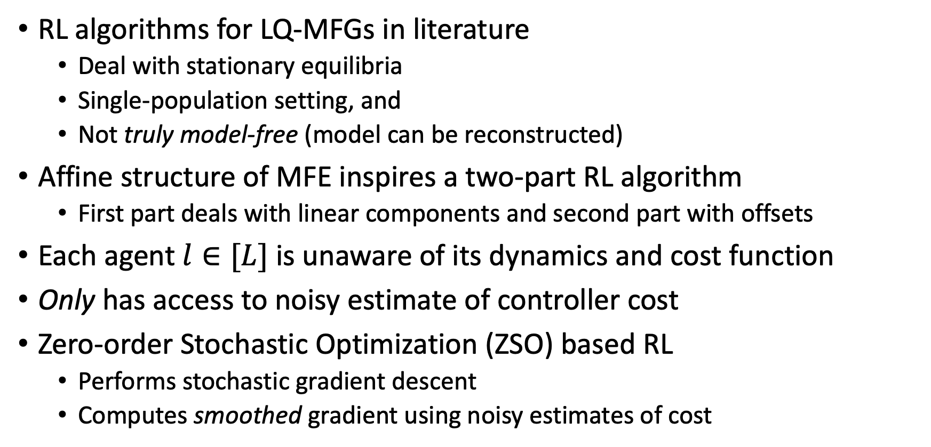
RL for Multi-Population MFGs
RL algorithms for LQ-MFGs in literature
Deal with stationary equilibria
Single-population setting, and
Not truly model-free (model can be reconstructed)
Affine structure of MFE inspires a two-part RL algorithm
First part deals with linear components and second part with offsets
Each agent $l∈[L]$ is unaware of its dynamics and cost function
Only has access to noisy estimate of controller cost
Zero-order Stochastic Optimization (ZSO) based RL
Performs stochastic gradient descent
Computes smoothed gradient using noisy estimates of cost

Slide 20
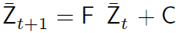
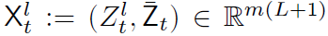
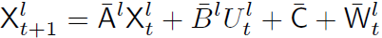
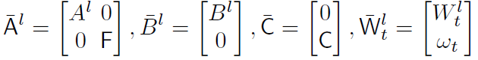
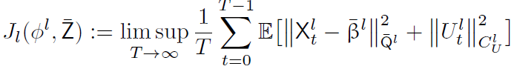
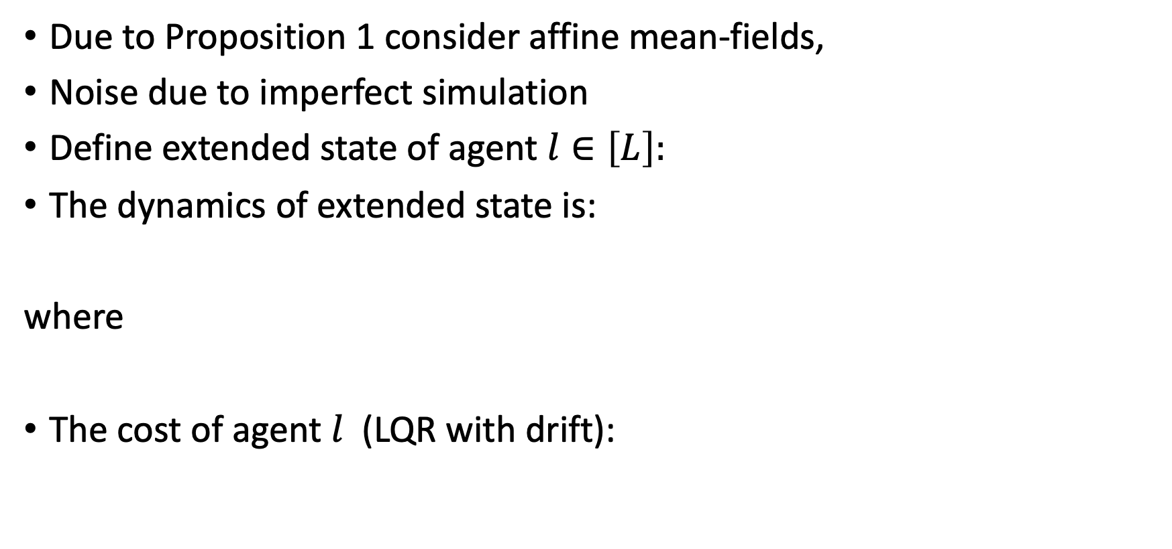
Formulation as Drifted-LQR
Due to Proposition 1 consider affine mean-fields,
Noise due to imperfect simulation
Define extended state of agent $l∈\left[L\right]:$
The dynamics of extended state is:
where
The cost of agent $l$ (LQR with drift):

Slide 21
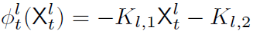
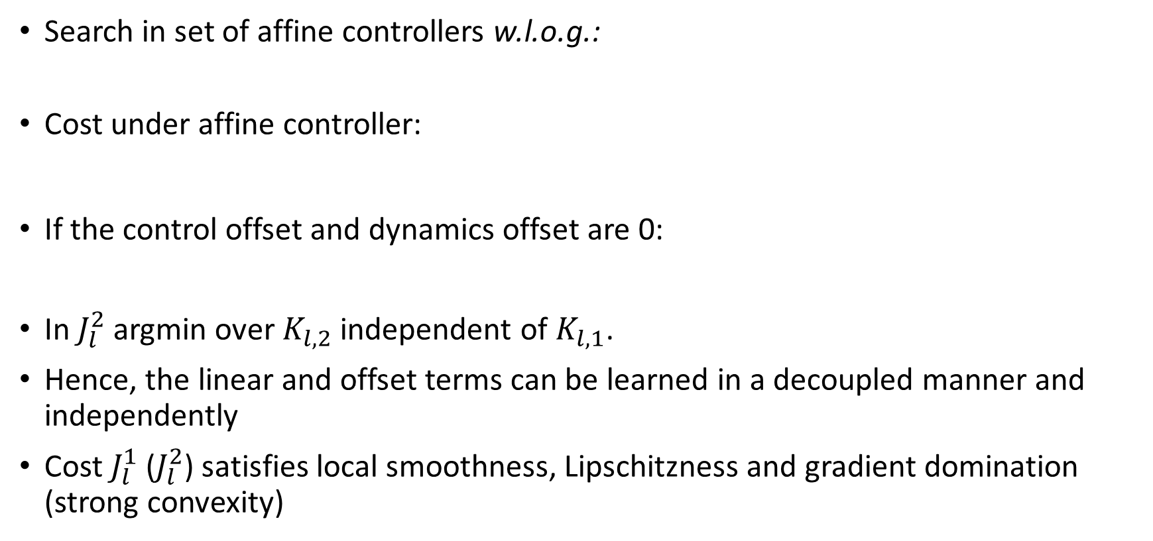
Formulation as Drifted-LQR
Search in set of affine controllers w.l.o.g.:
Cost under affine controller:
If the control offset and dynamics offset are 0:
In $J_{l}^{2}$ argmin over $K_{l,2}$ independent of $K_{l,1}$.
Hence, the linear and offset terms can be learned in a decoupled manner and independently
Cost $J_{l}^{1}$ ($J_{l}^{2}$) satisfies local smoothness, Lipschitzness and gradient domination (strong convexity)

Slide 22

RL for Multi-Population MFGs
The RL algorithm is divided into two parts for each agent $l∈[L]$:
first part estimates linear terms
second part estimates offset terms
In both parts, each agent uses ZSO to estimate controller parameters
Centralized simulator computes the mean-field under the set of controllers
First part deals with linear terms in controllers and mean-fields
MF offset is 0 if controller offset is 0
Second part deals with offset terms in the controllers and mean-fields
MF offset changes as a result of changing controller offset

Slide 23



Centralized Simulator
Simulator simulates the behavior of a single agent in each population as an estimate for the mean-field
Under controller the mean-field of population $l$ is
In first part of algorithm, linear controller (control offset $=0$)
As a result, linear mean-field:
In second part of algorithm, the controller is affine
As a result, affine mean-field:

Slide 24



ZSO based RL Algorithm
ZSO updates linear controller $∀l∈[L]$
Estimating Linear Terms
Simulator updates linear MF
ZSO updates control offset $∀l∈[L]$
Estimating Offset Terms
Simulator updates MF offset

Slide 25



ZSO Algorithm
ZSO is a stochastic gradient descent algorithm (SGD)
SGD is performed using smoothed gradient of a function $f$
ZSO pseudocode
Initialize x
For $r∈\{1,…,R\}$
\\ Generate $k$ perturbations with norm $r$
Generate $e^{i}\sim \left(r\right), ∀ i ∈\{1,…,k\}$
Compute smoothed gradient $\hat{∇}f$
$\hat{∇}f(x)= \frac{1}{k}\sum_{l=1}^{k}{\frac{mL}{r^{2}}}f(x+e^{l})e^{l}$
$x←x−η\hat{∇}f(x)$

Slide 26

RL for Multi-Population MFGs
Parameters of ZSO:
The perturbation norm is $r$ (smoothing radius)
The number of perturbations is $k$ (minibatch size)
The learning rate is denoted by η
Number of iterations $R$
Decreasing $r$decreases bias but increases variance of $\hat{∇}f$
Variance of $\hat{∇}f$is reduced by increasing $k$.
Learning rate η tradeoff between stability and speed
Better convergence of ZSO (ideally) for higher $R$

Slide 27



Finite Sample guarantees for ZSO (Linear)
Finite sample convergence for ZSO in first part of Algorithm
Specifies values for,
Number of iterations $R_{1}$
Smoothing radius $r_{1}$
Mini-batch size $k_{1}$
Learning rate $η_{1}$
Depends on properties of $J_{l}^{1}$
Corollary of results from (Malik et al., 2019) and (Fu et. Al., 2020)

Slide 28


Finite Sample guarantees for ZSO (Offset)
Finite sample convergence for ZSO in second part of Algorithm
Specifies values for
Number of iterations $R_{2}$
Smoothing radius $r_{2}$
Mini-batch size $k_{2}$
Learning rate $η_{2}$
Depends on properties of $J_{l}^{2}$
Provides convergence of controller to arbitrary threshold

Slide 29

Finite Sample guarantees for ZSO (Offset)
Hard to prove convergence of SGD due to
Non-convexity of set of feasible controllers
Outline of Proof
Start by defining sub-level sets dependent on initial cost
Prove “local” smoothness ${(λ}_{2}^{l})$, Lipschitzness ${(φ}_{2}^{l})$ and strong convexity ${(ν}^{l})$ properties of cost $J_{l}^{2}$ inside sub-level sets
Quantify error between smoothed gradient and exact gradient inside sub-level sets
Compute bound on stepsize to ensure local smoothness
Convergence follows due to strong convexity

Slide 30


Finite Sample guarantees for ZSO-RL
Finite sample convergence for RL algorithm:
Under standard assumptions in MFE lit. (Zaman et al., 2020b: Saldi et al., 2018).
Specifies values for
Number of iterations of first and second parts of algo $S_{1}$ and $S_{2}$
Convergence and confidence bounds for ZSO algorithms $ε_{1},δ_{2},ε_{2}$ and $δ_{2}$
Provides convergence of MFE to arbitrary threshold

Slide 31
Finite Sample guarantees for ZSO-RL
Outline of Proof
Proof consists of two parts,
First part deals with linear terms in MFE,
Second part deals with offset terms, and relies on convergence of first part
Estimation error in ZSO cause asymmetry in computed mean-fields
By bounding error in ZSO, the asymmetric error in mean-field is bounded
Mean-field update (using output of ZSO) is characterized for both parts of algorithm
Convergence is proved using contraction property of mean-field update
Finally, the global constants for cost functions are characterized, which depend on initial conditions and agents’ dynamics and cost functions

Slide 32

Numerical Analysis
We simulate the algorithm for a 3 populations in a
Chain network
Ring network
Scalar state and action spaces
Plots show estimation error and std. dev. of the MFE
Fast initial drop and steady decline

Slide 33
Conclusion
We have addressed Multi-Agent RL from a MFG perspective
The MFG involves heterogeneous agents grouped in populations
We have established existence, uniqueness & affine structure of the MFE and also established ε-Nash guarantees
The affine structure has inspired a two-part RL algorithm to estimate the MFE
ZSO techniques are used in the RL algorithm
Provided finite sample convergence guarantees for the algorithm
Provided numerical analysis for a 3-population setting

Slide 34




References

Slide 35




References

Slide 36



References

